Slide 1
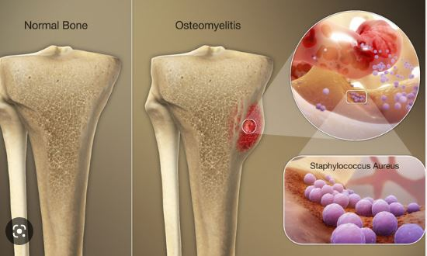
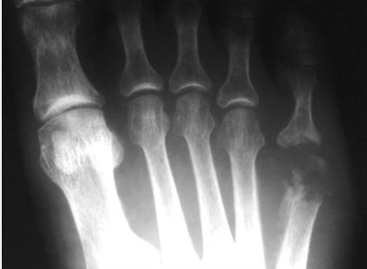
University of Basrah
College of Nursing
Fundamentals of Nursing Department
Second stage
Adult Nursing (II) 2nd Stage
Lecture 1 (Theory)
Musculoskeletal Infections ( Osteomyelitis )
Dr. Mohamad Abdulridha
Orthopedic Surgeon
M.B.CH.B F.I.C.M.S (ORTHO)

Slide 2
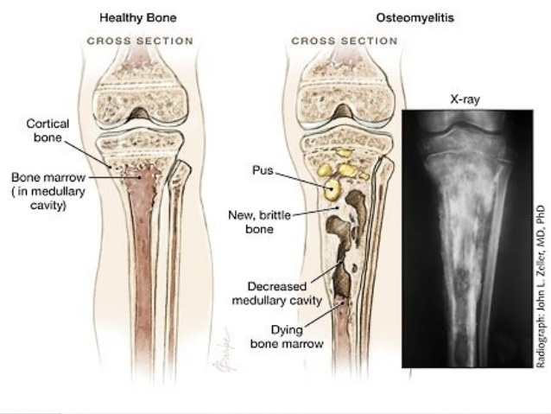
Musculoskeletal Infections OSTEOMYELITIS
Osteomyelitis is an infection of the bone that results in inflammation, necrosis, and formation of new bone
Osteomyelitis is classified as: 1.Hematogenous osteomyelitis (ie, due to bloodborne spread of infection) 2.Contiguous-focus osteomyelitis, from contamination from bone surgery, open fracture, or traumatic injury (eg, gunshot wound) 3.Osteomyelitis with vascular insufficiency, seen most commonly among patients with diabetes and peripheral vascular disease, most commonly affecting the feet

Slide 3
High risk patients

Slide 4
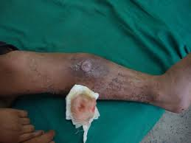
Bone infections are more difficult to eradicate than soft tissue infections because the infected bone is mostly avascular and not accessible to the body’s natural immune response. Also, there is decreased penetration by antibiotics. Osteomyelitis may become chronic and may affect the patient’s quality of life

Slide 5
Classification Based on the duration of symptoms
Acute:
<2weeks
Early acute
Late acute(4-5days)
Subacute:
2weeks—6weeks
Less virulent – more immune
Chronic:
>6 weeks

Slide 6
Organisms Isolated in Bacterial Osteomyelitis
Organism 1 .Staphylococcus aureus 2.Coagulase-negative staphylococci or Propionibacterium species 3.Enterobacteriaceae species orPseudomonas aeruginosa 4.Streptococci or anaerobic bacteria 5.Salmonella species or Streptococcus pneumoniae | Comments 1.Organism most often isolated in all types of osteomyelitis , MRSA 2.Foreign-body–associated infection 3.Common in nosocomial infections and punchured wounds 4.Associated with bites, fist injuries caused by contact with another person’s mouth, diabetic foot lesions, decubitus ulcers 5.Sickle cell disease

Slide 7
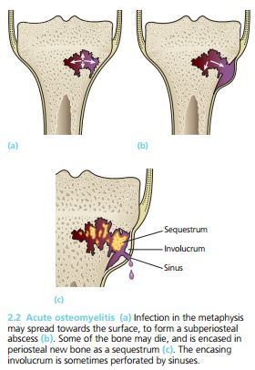
Pathophysiology
1. The earliest change in the metaphysis is an acute inflammatory reaction with vascular congestion, exudation of fluid and infiltration by leucocytes. The intraosseous pressure rises rapidly, causing intense pain, obstruction to blood flow and intravascular thrombosis
2. By the second or third day, pus forms
within the bone and forces its way along
the Volkmann canals to the surface where it produces a subperiosteal abscess..From the subperiosteal abscess pus can spread
along the shaft, to re-enter the bone at
another level or burst into the surrounding
soft tissues.

Slide 8
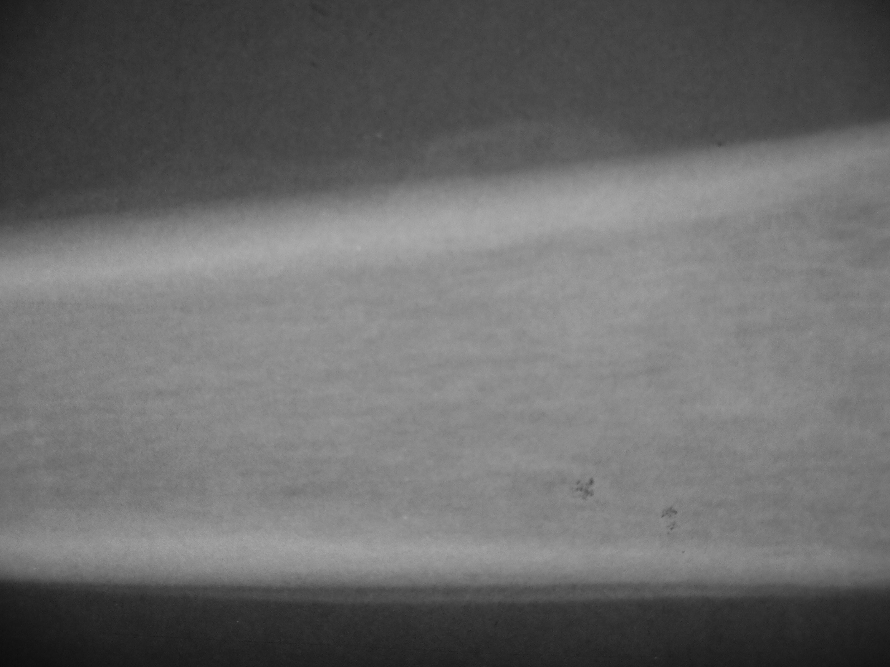
3. by the end of a week there is usually microscopic evidence of bone death. Bacterial toxins and leucocytic enzymes also may play their part in the advancing tissue destruction. With the gradual ingrowth of granulation tissue the boundary between living and devitalized bone becomes defined. Pieces of dead bone may separate as sequestra varying in size from mere spicules to large necrotic segments of the cortex in neglected cases.
4. Another feature of advancing acute osteomyelitis is new bone formation, streaks of subperiosteal new bone usually become apparent on x-ray by the end of the second week. With time this new bone thickens involucrum, enclosing the sequestrum and infected tissue 5. resolution and healing or else intractable chronicity

Slide 9
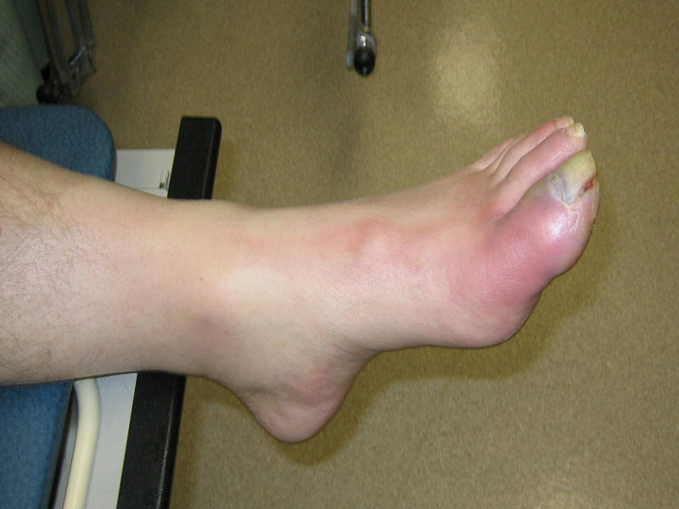
Clinical Manifestations
When the infection is blood borne, the onset is usually sudden, occurring often with the clinical and laboratory manifestations of sepsis (eg, chills, high fever, rapid pulse, general malaise). The systemic symptoms at first may overshadow the local signs. As the infection extends through the cortex of the bone, it involves the periosteum and the soft tissues. The infected area becomes painful, swollen, and extremely tender. The patient may describe a constant, pulsating pain that intensifies with movement as a result of the pressure of the collecting purulent material (ie, pus).
When osteomyelitis occurs from spread of adjacent infection or from direct contamination, there are no symptoms of sepsis. The area is swollen, warm, painful, and tender to touch.
The patient with chronic osteomyelitis presents with a non healing ulcer that overlies the infected bone with a connecting sinus that will intermittently and spontaneously drain pus

Slide 10
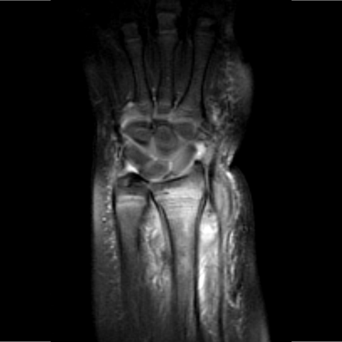
Assessment and Diagnostic Finding
1. In acute osteomyelitis, early x-ray findings demonstrate soft tissue edema. In about 2 to 3 weeks, areas of periosteal elevation and bone necrosis are evident. Radioisotope bone scans, particularly the isotope-labeled white blood cell (WBC) scan, and magnetic resonance imaging (MRI) help with early definitive diagnosis.
Blood studies reveal leukocytosis and an elevated ESR and CRP . Wound and blood culture studies are performed, although they are only positive in 50% of cases. Therefore, treatment with antibiotics may be prescribed without definitively isolating the offending organism .
2. With chronic osteomyelitis, large, irregular cavities; raised periosteum; sequestra; or dense bone formations are seen on x-ray. Bone scans may be performed to identify areas of infection. The ESR and the WBC count are usually normal. Anemia, associated with chronic infection may be evident. Cultures of blood specimens and drainage from the sinus tract are frequently unreliable; antibiotic therapy is many times prescribed presumptively without isolating the offending pathogen.
An open bone biopsy is indicated as percutaneous aspirations are not reliable for gathering cultures to identify the underlying pathogen (

Slide 11
Prevention
Prevention of osteomyelitis is the goal.
Elective orthopedic surgery should be postponed if the patient has a current infection (eg, urinary tract infection, sore throat) or a recent history of infection.
During orthopedic surgery, careful attention is paid to the surgical environment and to techniques to decrease direct bone contamination.
Prophylactic antibiotics, administered to achieve adequate tissue levels at the time of surgery and for 24 hours after surgery, are helpful.
Urinary catheters and drains are removed as soon as possible to decrease the incidence of hematogenous spread of infection.
Aseptic postoperative wound care reduces the incidence of superficial infections and osteomyelitis.
When patients who have had joint replacement surgery undergo dental procedures or other invasive procedures (eg, cystoscopy), prophylactic antibiotics are frequently recommended.

Slide 12
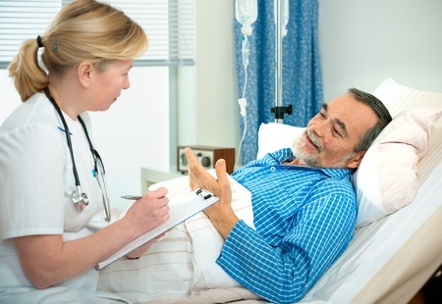
Medical Management Medical Management
The initial goal of therapy is to control and halt the infective process. Antibiotic therapy depends on the results of blood and wound cultures. General supportive measures (eg, hydration, diet high in vitamins and protein, correction of anemia) should be instituted. The area affected with osteomyelitis is immobilized to decrease discomfort and to prevent pathologic fracture of the weakened bone

Slide 13
Pharmacologic Therapy
As soon as the culture specimens are obtained, IV antibiotic therapy begins, based on the assumption that infection results from a staphylococcal organism that is sensitive to a penicillin or cephalosporin.
The aim is to control the infection before the blood supply to the area diminishes as a result of thrombosis.
Around-the-clock dosing is necessary to maintain a high therapeutic blood level of the antibiotic.
After results of the culture and sensitivity studies are known, an antibiotic to which the causative organism is sensitive is prescribed.
IV antibiotic therapy continues for 3 to 6 weeks.
After the infection appears to be controlled, the antibiotic may be administered orally for up to 3 months?.
To enhance absorption of the orally administered medication, antibiotics should not be administered with food

Slide 14
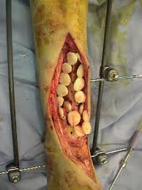
Surgical Management
If the infection is chronic and does not respond to antibiotic therapy, surgical débridement is indicated. The infected bone is surgically exposed, the purulent and necrotic material is removed, and the area is irrigated with sterile saline solution.
Antibiotic-impregnated beads may be placed in the wound for direct application of antibiotics for 2 to 4 weeks .IV antibiotic therapy is continued. In chronic osteomyelitis, antibiotics are adjunctive therapy to surgical débridement. A sequestrectomy (removal of enough involucrum to enable the surgeon to remove the sequestrum) is performed.
All dead, infected bone and cartilage must be removed before permanent healing can occur. A closed suction irrigation system may be used to remove debris. Wound irrigation using sterile physiologic saline solution may be performed for 7 to 8 days. The wound is either closed tightly to obliterate the dead space or packed and closed later by granulation or possibly by grafting. The débrided cavity may be packed with cancellous bone graft to stimulate healing.
With a large defect, the cavity may be filled with a vascularized bone transfer or muscle flap (in which a muscle is moved from an adjacent area with blood supply intact). These microsurgery techniques enhance blood supply. These surgical procedures may be staged over time to ensure healing. Because surgical débridement weakens the bone, internal fixation or external supportive devices may be needed to stabilize or support the bone to prevent pathologic fracture .

Slide 15
Nursing Interventions
Relieving Pain
The affected part may be immobilized with a splint to decrease pain and muscle spasm.
The nurse monitors the neurovascular status of the affected extremity.
The wounds are frequently very painful, and the extremity must be handled with great care and gentleness.
Elevation reduces swelling and associated discomfort.
Pain is controlled with prescribed analgesic agents and other pain-reducing techniques.

Slide 16
2. Improving Physical Mobility
Treatment regimens restrict activity.
The bone is weakened by the infective process and must be protected by immobilization devices and by avoidance of stress on the bone.
The patient must understand the rationale for the activity restrictions.
The joints above and below the affected part should be gently moved through their range of motion.
The nurse encourages full participation in ADLs within the physical limitations to promote general well-being.

Slide 17
3.Controlling the Infectious Process
The nurse monitors the patient’s response to antibiotic therapy and observes the IV access site for evidence of phlebitis, infection, or infiltration.
With long-term, intensive antibiotic therapy, the nurse monitors the patient for signs of superinfection (eg, oral or vaginal candidiasis, loose or foul-smelling stools).
If surgery is necessary, the nurse takes measures to ensure adequate circulation to the affected area (wound suction to prevent fluid accumulation, elevation of the area to promote venous drainage, avoidance of pressure on the grafted area), to maintain needed immobility, and to ensure the patient’s adherence to weight-bearing restrictions.
The nurse changes dressings using aseptic technique to promote healing and to prevent cross-contamination.
The nurse continues to monitor the general health and nutrition of the patient. A diet high in protein promotes a positive nitrogen balance and healing. The nurse encourages adequate hydration as well

Slide 18
4. Promoting Home and Community-Based Care
A.TEACHING PATIENTS SELF-CARE.
The patient and family are taught about the importance of strictly adhering to the therapeutic regimen of antibiotics and preventing falls or other injuries that could result in bone fracture. They need to learn to maintain and manage the IV access and IV administration equipment in the home. Teaching includes medication name, dosage, frequency, administration rate, safe storage and handling, adverse reactions, and necessary laboratory monitoring.
In addition, aseptic dressing and warm compress techniques are taught.
The nurse carefully monitors the patient for the development of additional sites that are painful or sudden increases in body temperature.
The nurse instructs the patientand family to observe for and report elevated temperature, drainage, odor, signs of increased inflammation, adverse reactions, and signs of superinfection.

Slide 19
B. CONTINUING CARE
The home care environment needs to be conducive to the promotion of health and to the requirements of the therapeutic regimen.
If warranted, the nurse completes a home assessment to determine the patient’s and family’s abilities regarding continuation of the therapeutic regimen. If the patient’s support system is questionable or if the patient lives alone, a home care nurse may be needed to assist with IV administration of the antibiotics.
The nurse monitors the patient for response to the treatment, signs and symptoms of superinfections, and adverse drug reactions. The nurse stresses the importance of follow-up health care appointments and recommends age appropriate health screening
SEPTIC ARTHRITIS ?

Slide 20
Summary
1. Know how Osteomyelitis occur ?
2. Risk factor for Osteomyelitis
3. Management of Osteomyelitis
4. Nursing management of Osteomyelitis

Slide 21
Questions
The specific treatment for chronic osteomyelitis would be: A. Immobilization.
B. Drainage of localized foci of infection.
C. Radiotherapy
D. Antibiotic therapy.
E. Surgical removal of the sequestrum.

Slide 22
Questions
Osteomyelitis is an infection of the bone, that is commonly caused by A. Staphylococcus aureus bacteria
B. Streptococcus bacteria.
C. Escherichia Coli.
D. Pseudomonas aeruginosa.
E. Pneumococcal bacteria

Slide 23
Questions
Expected patient outcomes for a patient with osteomyelitis include: A. Bone abscess formation
B. Inflammation and edema
C. Impaired physical mobility.
D. Decreased pain at rest
E. Increased pain at rest

Slide 24
Questions
A patient with diabetes has been diagnosed with osteomyelitis. The nurse notes that the patients right foot is pale and mottled, cool to touch, with a capillary refill ofgreater than 3 seconds. The nurse should suspect what type ofosteomyelitis?
A) Hematogenous osteomyelitis B) Osteomyelitis with vascular insufficiency C) Contiguous-focus osteomyelitis D) Osteomyelitis with muscular deterioration

Slide 25
Reference
Textbook of medical-surgical nursing Description: 14th edition. | Philadelphia : Wolters Kluwer, [2018], ISBN 9781496355157 (2-volume American edition)

